Slide 1
Aligning with Standards: k-12
Effects on syllabus and lesson planning
Presented By: Andrea Salem
August 16, 2012

Slide 2
Vignette
In 2011, Dr. Ghaderi approved the MCPS EIC Standards alignment for the Math Department initiated by Sr. Rayan Issa. It was not long after that he came to me requesting that ELA be aligned to MCPS Standards as well. At that point in time, the Literacy Initiative was still in the process of being implemented and the Progress Monitoring and the subsequent PDs was a priority. I had to pick my battles. I told Dr. Ghaderi that because teaching of English Language Arts is very abstract, it would be beneficial to do it during the in-service training in the summer. Providing all ELA/English teachers with the binder that holds the MCPS’ Elementary Integrated Curriculum and Maryland Common Core Standards Framework, I told the team that these resources are being handed to them to look over during the winter break. They were further told that they can use it in their Final Semester syllabus planning following the approach used in aligning the Math standards, if they so wish. I assured them that it is NOT the priority for school year 2011-2012 BUT it will be tackled and done during the summer 2012 in-service training.

Slide 3
Training Objectives:
Gain knowledge of the historical background of the Standards Reform.
Identify the steps in aligning standards, benchmarks, and the curricula.
Participate in hands-on activities that demonstrate ability to align standards using prior and new learned knowledge.
Reflect on the importance of aligning the curricula with Standards.

Slide 4
All About Standards
Historical overview

Slide 5
Standards In a nutshell
What gets taught, when, and by whom.
Push to develop a Common Core of State Standards in Language Arts and Mathematics across the United States.
Raised accountability on teaching practices to meet the prescribed standards for each grade level benefiting all students.

Slide 6
A closer look
 | Federal | State | Alim Academy
Mandates | NCLB NGA Common Core State Standards | Common Core Standards Framework For MCPS: Elementary Integrated Curriculum K-5 MS/HS: Common Core Standards Framework | The textbook is used as curricula with alignment to Maryland standards. In SY 2011-2012, a push for alignment to MCPS Standards was initiated

Slide 7
A car-buying analogy
Federal | State | Alim Academy
2 WD Specs: Meets NCLB / NGA Common Core State Standards | 4 WD Specs: Meets MCPS’ EIC Standards for K-5 Meets Maryland’s CCSS for Middle School and High School | 4 WD Limited Edition Specs: Meets MCPS’s Standards. Meets the school’s Islamic orientation and needs.

Slide 8
Simply said…
Alim Academy: A Market Analysis
AA caters to a specific market—families in the MD-DC-VA area who are in search of a culturally responsive learning community that cultivates and respects:
Practice of religion and immersion in Islamic studies and way of life
Ethnicity, ancestry & heritage
Diverse background

Slide 9
Steps to Follow
in Aligning Standards, Benchmarks, & Curricula

Slide 10
5 Easy Steps
Know the standards or sub-standards (outcomes and indicators) WHAT
List performance expectations for each semester. WHEN
Describe formal & informal assessments for the Standards. HOW
Identify sample activity/s used to teach the strategy or skill. WHAT
List the resources or tools used to mediate the learning activities. WHERE

Slide 11
What source/s do we use?
A practical application
4th Grade Social Studies
Agency | Resource
Federal Standards | Our Country’s Regions Textbook
Maryland State Standards | Our Country’s Regions Textbook + Maryland Book
Alim Academy + MCPS Standards | Our Country’s Regions Textbook + Maryland Book + Supplemental Instructional Materials and culturally responsive instruction/fieldtrips/activities

Slide 12
Using explicit, direct instruction to demonstrate how to align with standards
Standard
Standard1.0 Political Science
(CCSS)
Indicator
2.5.B.2. Analyze how increased diversity in the colonies resulted from immigration, settlement patterns and economic development. (MCPS’ EIC)
Desired Outcomes
Analyze how the influx of immigrants led to economic growth and cultural diversity. (MCPS’ EIC)
Sources /Activities / Assessments
Maryland Today / Fieldtrip, G.O., Outline / Writing activities, Teacher-Constructed Test, Quarter Test

Slide 13
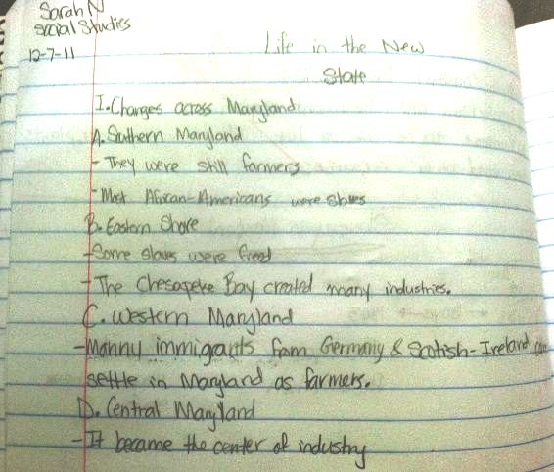

Slide 14
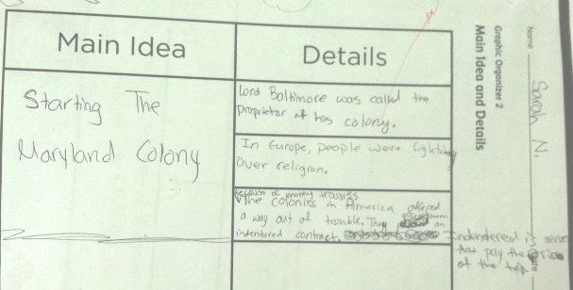

Slide 15
Hands-On Activities
Sorting, Matching, Aligning, evaluting

Slide 16
Activity 1: Sorting
Using the steps discussed and template (1) provided, sort out the sentences/statements provided to your group.
Activity 2: Matching & Aligning
Using template 2, match the standards to the sub-standards/indicators, and outcomes.
THEN identify what CORE Subject the standard belongs to using other information available.
Activity 3: Performance Evaluation
Choose two (2) student works that demonstrate 2 of your aligned core subject standard/s. Use template (2) and appoint a group reporter for sharing.

Slide 17
RECAP: Using Strategies
3-2-1 Jigsaw & Value line-up

Slide 18
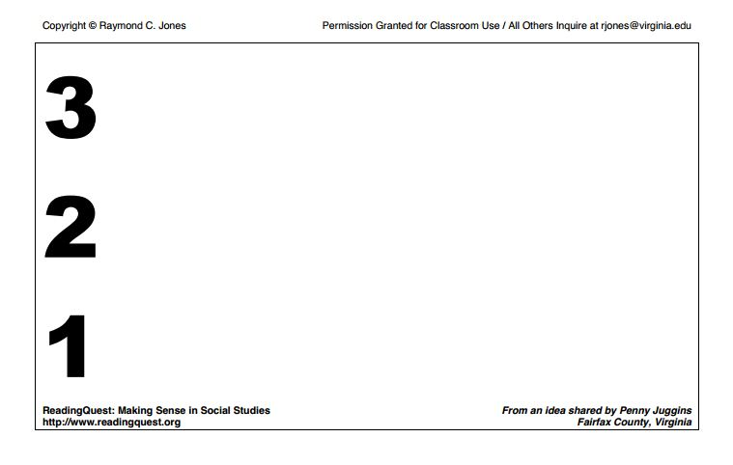
---- things you found out:
---- interesting things:
---- question you still have
Value Line-UP Instruction
Find your letter match and share Number 2 from your 3-2-1 Jigsaw.

Slide 19
CONCLUSION
Putting it all together

Slide 20
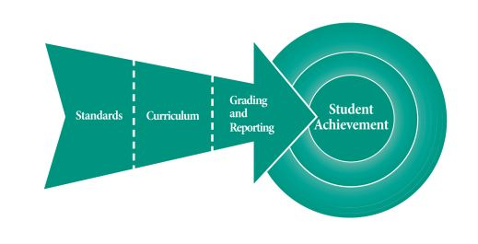
Standards are the backbone of a successful curriculum.
A great synergy between standards, materials, planning, and classroom instruction will be reflected in the degree of achievement our students demonstrate.

Slide 21
Thank you.
Please complete the Trainer Evaluation Form and submit it to Sr. Sommayah before leaving the room.

